Slide 1




NEXT GEN EMPLOYABILITY PROGRAM
Creating a future-ready workforce
Team Members
College Name
Student Name : Hariharan K
Student ID : 513521104016
Annai Mira College of Engineering and Technology (5135)

Slide 2

CAPSTONE PROJECT SHOWCASE
Project Title
Building Bus Reservation System using Python and Django
Abstract | Problem Statement | Project Overview | Proposed Solution | Technology Used | Modelling & Results | Conclusion

Slide 3
Abstract
The Bus Reservation System is a comprehensive web application built on the Django framework. It provides users a seamless platform to search, book, and manage their bus travel. At the core is a robust user management module, allowing customers to create accounts, log in securely, and access their booking history.
The booking process is user-friendly, with registered users able to select their preferred bus, choose seats
Complementing the user-facing features is an administrative dashboard for bus operators. This provides tools to manage routes, schedules, and pricing, as well as monitor bookings and analyze trends to optimize services and improve the passenger experience.
Designed with scalability, security, and usability in mind, the Bus Reservation System leverages Django's capabilities to revolutionize bus travel booking and empower operators to better serve their customers.
Source :

Slide 4
Problem Statement
Existing bus booking systems typically involve complex and time-consuming processes that create friction for passengers trying to plan their travel. Customers often struggle to easily search for available routes, check real-time seat availability, and complete secure online bookings. Furthermore, bus operators lack efficient tools to manage their schedules, routes, and pricing in response to changing customer demand.
There is a pressing need for a comprehensive and user-friendly web-based solution that can revolutionize the bus reservation experience for both passengers and service providers. Such a system should empower customers to conveniently search, book, and manage their bus travel, while also equipping operators with the necessary capabilities to optimize their services, analyze booking trends, and make data-driven decisions to better cater to evolving passenger needs.
By leveraging the robust features and flexibility of the Django web framework, this Bus Reservation System aims to address these pain points and provide a streamlined platform that enhances the overall bus travel experience for all stakeholders.
Source :

Slide 5
Project Overview
The Bus Reservation System is a comprehensive web application developed using the Django framework. It provides an intuitive and user-friendly platform for passengers to conveniently search available bus routes, view schedules, check real-time seat availability, and seamlessly book their tickets through secure online payments.
Beyond the passenger-facing features, the system also offers a robust administrative dashboard for bus operators. This empowers them to efficiently manage their bus services, including updating schedules, routes, and ticket pricing. The dashboard also enables operators to monitor booking trends, analyze customer data, and make informed decisions to optimize their offerings and better cater to evolving passenger needs.
By leveraging the powerful capabilities of the Django framework, the Bus Reservation System aims to streamline the end-to-end bus travel experience for both customers and service providers. The system's scalable architecture, security features, and intuitive design ensure a seamless and enjoyable experience for all users, revolutionizing the way people book and manage their bus travel.
Source :

Slide 6
Proposed Solution
The Bus Reservation System will be developed as a comprehensive web application using the Django web framework. The system will provide a user-friendly and efficient interface for passengers to search, book, and manage their bus travel, while also offering a robust administrative dashboard for bus operators to optimize their services.
Key features of the proposed solution include:
1. User Management
2. Bus Schedule and Route Information
3. Ticket Booking and Reservation
4. Admin Dashboard
5. System Architecture and Technology
Source :

Slide 7
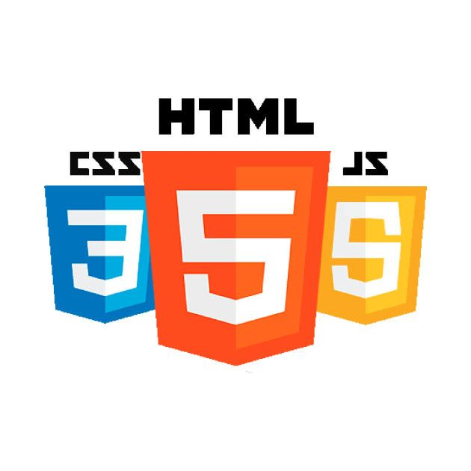
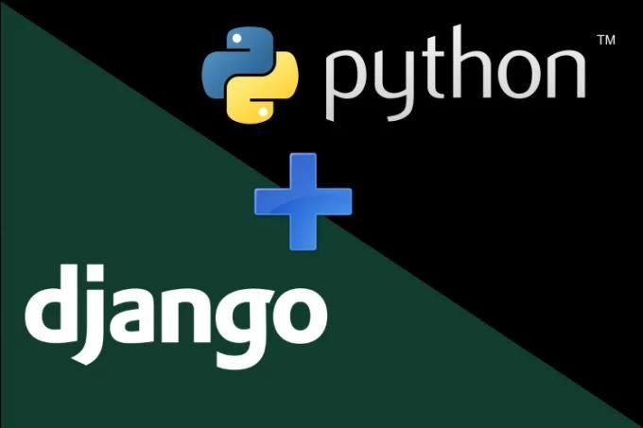
Technology Used
Front-end
Back-end
Source :

Slide 8
Modelling & Results
The Bus Reservation System is a comprehensive web application built on the Django framework. It provides an intuitive platform for passengers to search available bus routes, view schedules, check seat availability, and conveniently book their tickets through secure online payments.
Beyond the user-facing features, the system also offers a robust administrative dashboard for bus operators. This empowers them to efficiently manage their bus services, including updating schedules, routes, and ticket pricing. The dashboard also enables operators to monitor booking trends, analyze customer data, and make informed decisions to optimize their offerings and better serve passengers.
By leveraging the powerful capabilities of Django, the Bus Reservation System streamlines the end-to-end bus travel experience for both customers and service providers. The system's scalable architecture, security features, and user-friendly design ensure a seamless experience, revolutionizing the way people book and manage their bus travel.
Source :

Slide 9
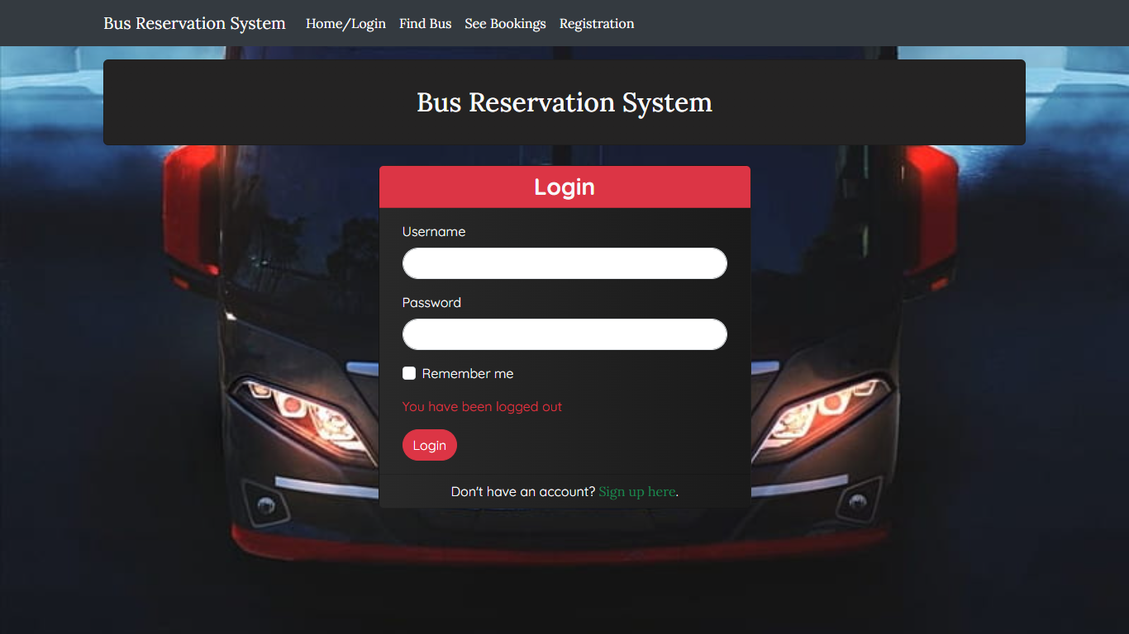
Homepage | Login
This is the index or the base of the project where the landing page loaded.
In this page the login page also integrated where the user is going to enter the login credentials.
If the entered credentials is not valid the user is asked to create a new user id.

Slide 10
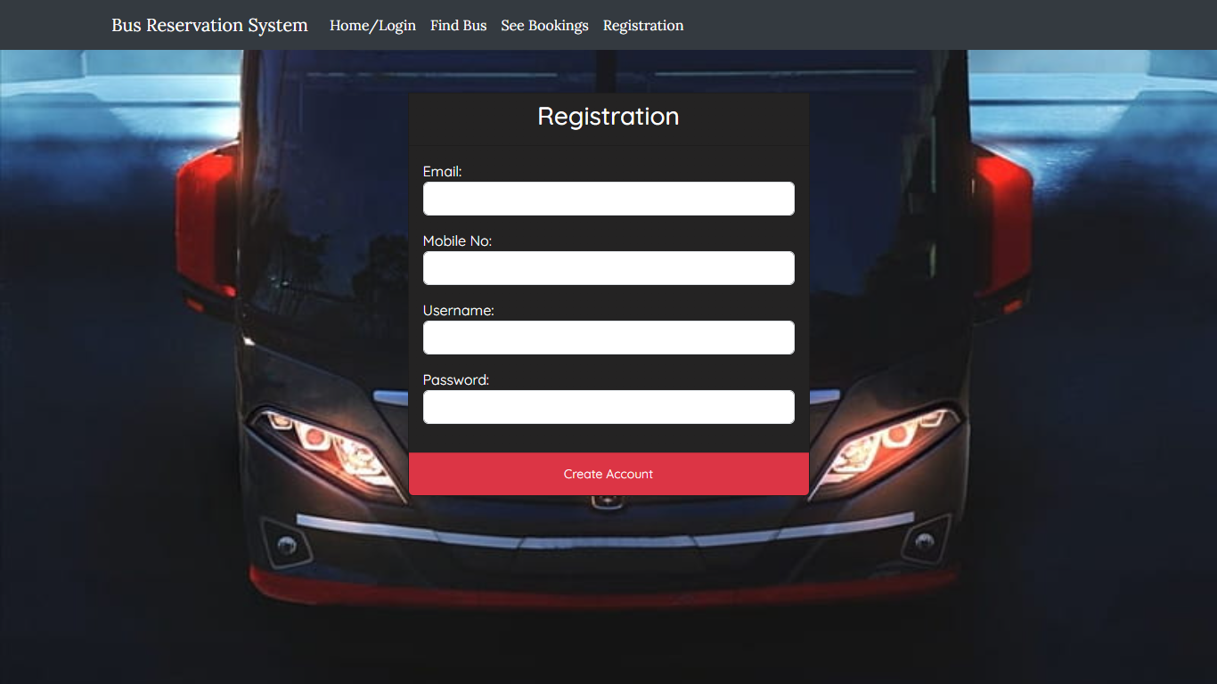
Register | Sign-up
Here, the registration or Signup process is done.
Users can create new username and password for logging in into the site.
The data are stored into the database using API call method POST.
During login these data's are cross checked.

Slide 11
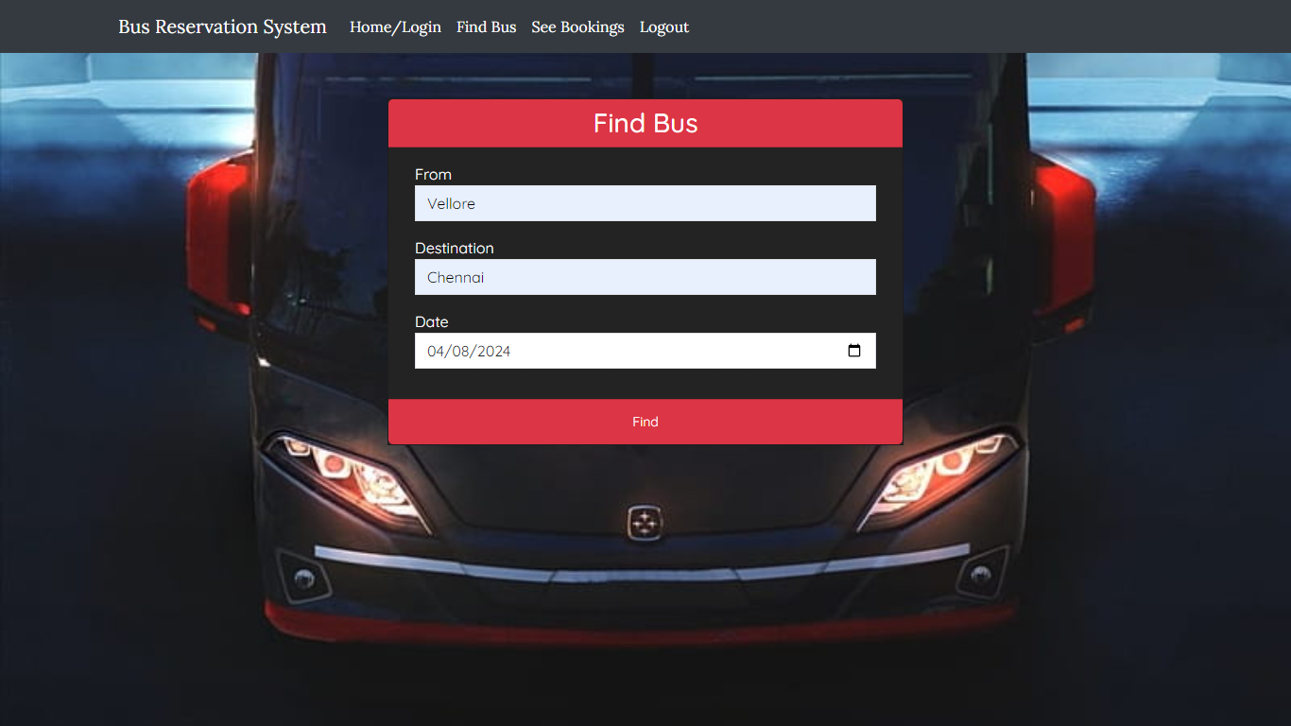
Find Bus | Booking
This is the Find Bus or Booking Page where the users can add the available bus
If the no. of seats are not available then it shows error message.
The UI is created user friendly that every user can easily access the Booking. .

Slide 12
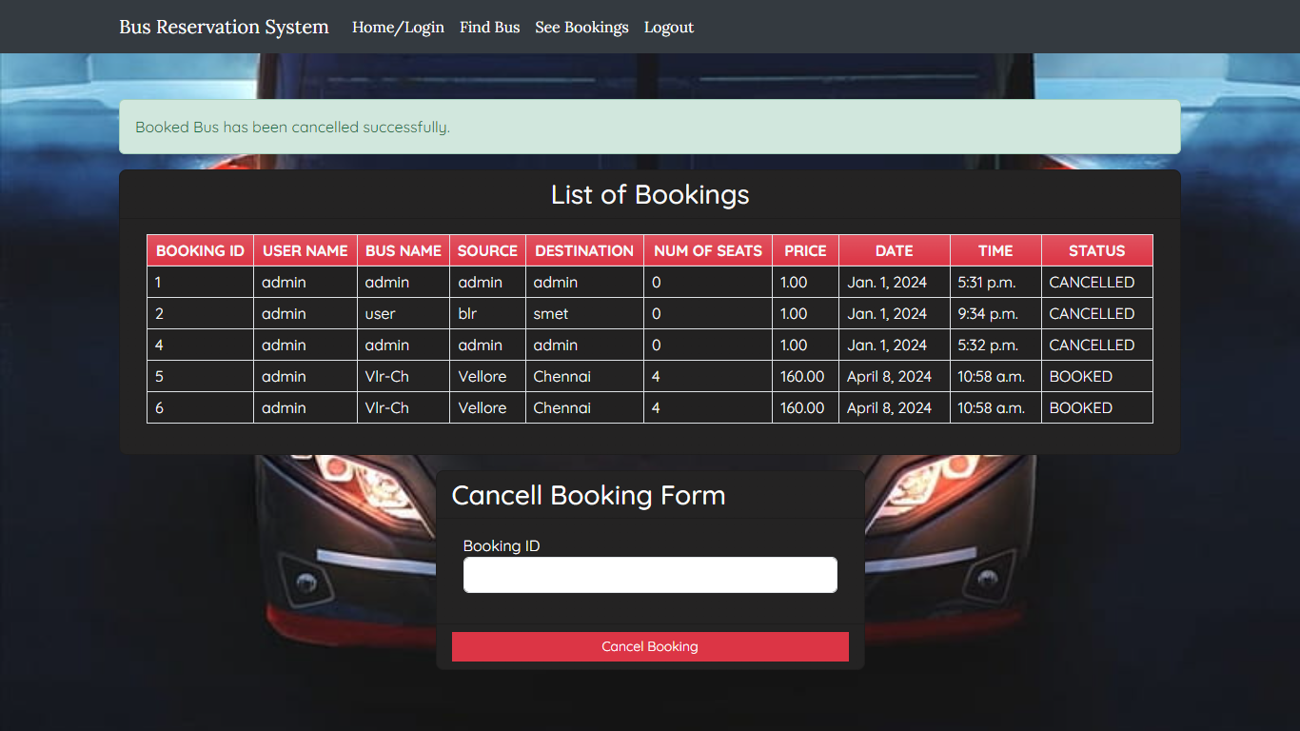
List of Bookings | Cancel Booking
Here the no. of buses booked and the no. of books cancelled are listed here.
Although the user can modify like cancel the booked tickets here.
This Page shows the entire transactions done in the booking process.

Slide 13
Future Enhancements:
1. Mobile App
2. Advanced Booking
3. Real-time Tracking
4. Revenue Optimization
5. Multi-modal Integration
6. Extensible APIs
7. Advanced Analytics
8. Internationalization

Slide 14
Conclusion
The Bus Reservation System, developed using Django, offers a comprehensive solution for passengers and bus operators. It provides an intuitive platform for users to conveniently search, book, and manage their bus travel. The system also empowers operators to efficiently manage services, optimize schedules and pricing, and gain valuable insights.
The modular and scalable Django-powered architecture ensures the system's ability to handle growing demands and evolving requirements. Its focus on security, reliability, and maintainability solidifies its position as a reliable long-term solution.
Future enhancements, such as mobile apps, advanced booking features, real-time tracking, revenue optimization, and multi-modal integration, will continue to revolutionize the bus travel experience for all stakeholders. The Bus Reservation System has the potential to become a leading platform in the bus transportation industry.
Source :

Slide 15
Thank You!
Notes:
Thank You !!

